Slide 1
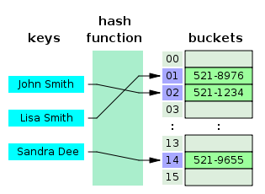
COSC 222 Data Structures
Yves Lucet
CC BY-SA 3.0 https://en.wikipedia.org/wiki/Skip_list#/media/File:Skip_list_add_element-en.gif
"Hash table 3 1 1 0 1 0 0 SP" by Jorge Stolfi - Own work. Licensed under CC BY-SA 3.0 via Commons - https://commons.wikimedia.org/wiki/File:Hash_table_3_1_1_0_1_0_0_SP.svg#/media/File:Hash_table_3_1_1_0_1_0_0_SP.svg

Slide 2


Slide 3
Programming context
MAPS 2022 Mount Allison Programming Showdown
https://mapscontest.com/

Slide 4

Menu Today
Teams tuned: Team 39 disbanded
RAT postmortem
Lab
Exercises: tMAT practice
Image courtesy of Grant Cochrane/ FreeDigitalPhotos.net
Notes:
Image courtesy of Grant Cochrane/ FreeDigitalPhotos.net

Slide 5
RAT results
All marks posted
Contact me asap if you disagree with your mark
Thank you to everyone who contacted me; the 2 errors were fixed

Slide 6
Lab
Clean install of Eclipse
Generate token
Use Eclipse as Git client
Free to use command line or any git client you like

Slide 7
TA contact information
First post in Ms Teams
TAs are paid hourly and not expected to have zoom meetings during weekends/holidays
If you are really desperate for TA help
Drop by another lab section provided
It has space; priority is for students in that lab section
You understand you will be graded by the TA assigned to your lab section

Slide 8
Reminder: testing

Slide 9
Unit Testing
Select your method signature: int Fact(int n)
Design your tests: Fact(0)==1; Fact(1)==1; Fact(3)==6; Fact(-1) error; Fact(10.5) error
Write your code for Fact(n)
Write your tests; run tests; fix till all tests pass
Depending on your task, you may or may not implement exceptions, e.g. you could forget about Fact(-1) in a 1-week lab and just put a comment in the code that no negative integers are expected.
Key principle: All the tests should run quickly (in 1-5s with 10s max) or you won’t run them each time you modify the code.
After every code change, run ALL the tests. This checks your change did not break something else.

Slide 10

Unit Tests are
reproducible
quick: running all tests should not take more than 5 seconds. The longer it takes, the less often you run them.
fully automated: all tests should run with a single click with no other user input needed whatsoever.
run every time the code is modified

Slide 11
Coverage Testing
Unit testing assesses whether your code works as expected
Coverage testing assesses whether your code has the bare minimum of tests
Line/statement coverage: after running all your unit tests, each line/statement should be executed once. This is the weakest metric
Other coverage metrics:
Function coverage: call each function
branch coverage: execute both the then and the else clauses for if statements
Condition coverage: check each Boolean evaluated to true and false

Slide 13
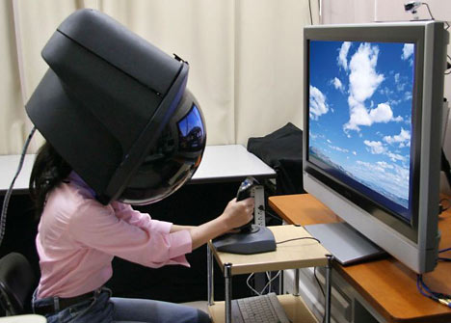
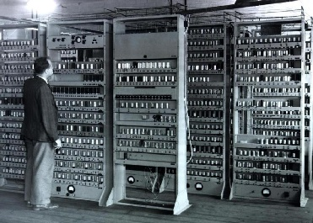
Module 1: Labs
Unit testing, comparing arrays, sorting
Coverage testing, counting sort
[unit/coverage testing expected from then on]
Generics
Streams

Slide 14
Feedback
Labs have imprecise formulation or are ambiguous
By design! It makes you more independent and prepare you to implement software instead of writing code. Yes it is less comfortable but software implementation is all about taking plenty of tiny decisions to deal with ambiguity.
You are no longer taught in class before a lab
Focus is on learning not teaching. Professor role is no longer to pre-digest material but to guide you through various material sources
Asking questions engages you so you relate the material with your previous knowledge resulting in much more efficient learning
Learning how to find answers online is a critical skill

Slide 15
Readings for today
See Readings page on Canvas
Topic: Arrays, Lists, cloning
Concepts: singly linked list, doubly linked list, circular linked list, dynamic array, deep/shallow/lazy copy
Java:
copy constructor, cloning, serialization, loop, stream
Arraycopy, addAll, copyOfRange, copyOf

Slide 16
tMAT
Build & Critic

Slide 17
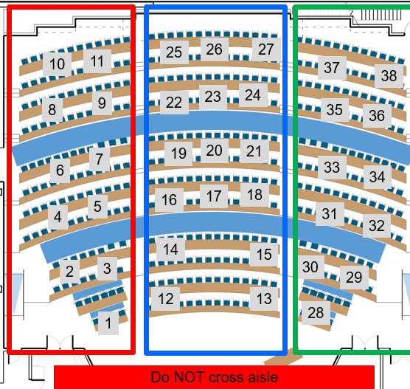
Team build & critic
Do not forget to assign a TIMEKEEPER
[10 marks] Answer the questions on your poster
write clearly
Take picture and post it on Canvas as group assignment tMAT0
[4 marks] Rotate posters on each aisle (left, centre, right); do NOT cross aisle. Critic 4 posters. Make a list of any error, bug, omission; is complexity correct?
The full team has to agree on the justification
Upload your poster to tMAT0
Be quick! We have to start even if you haven’t finished writing your poster!
Include the list of team members present today
On your poster
DO NOT USE INTERNET except to submit tMAT
30’
4’
Per
poster
Notes:
15’ post-mortem
10’ quiz
30’ write poster
16’ read 4 posters
Total = 71’ [only read 3 posters if 3rd poster is after 1:40]

Slide 18
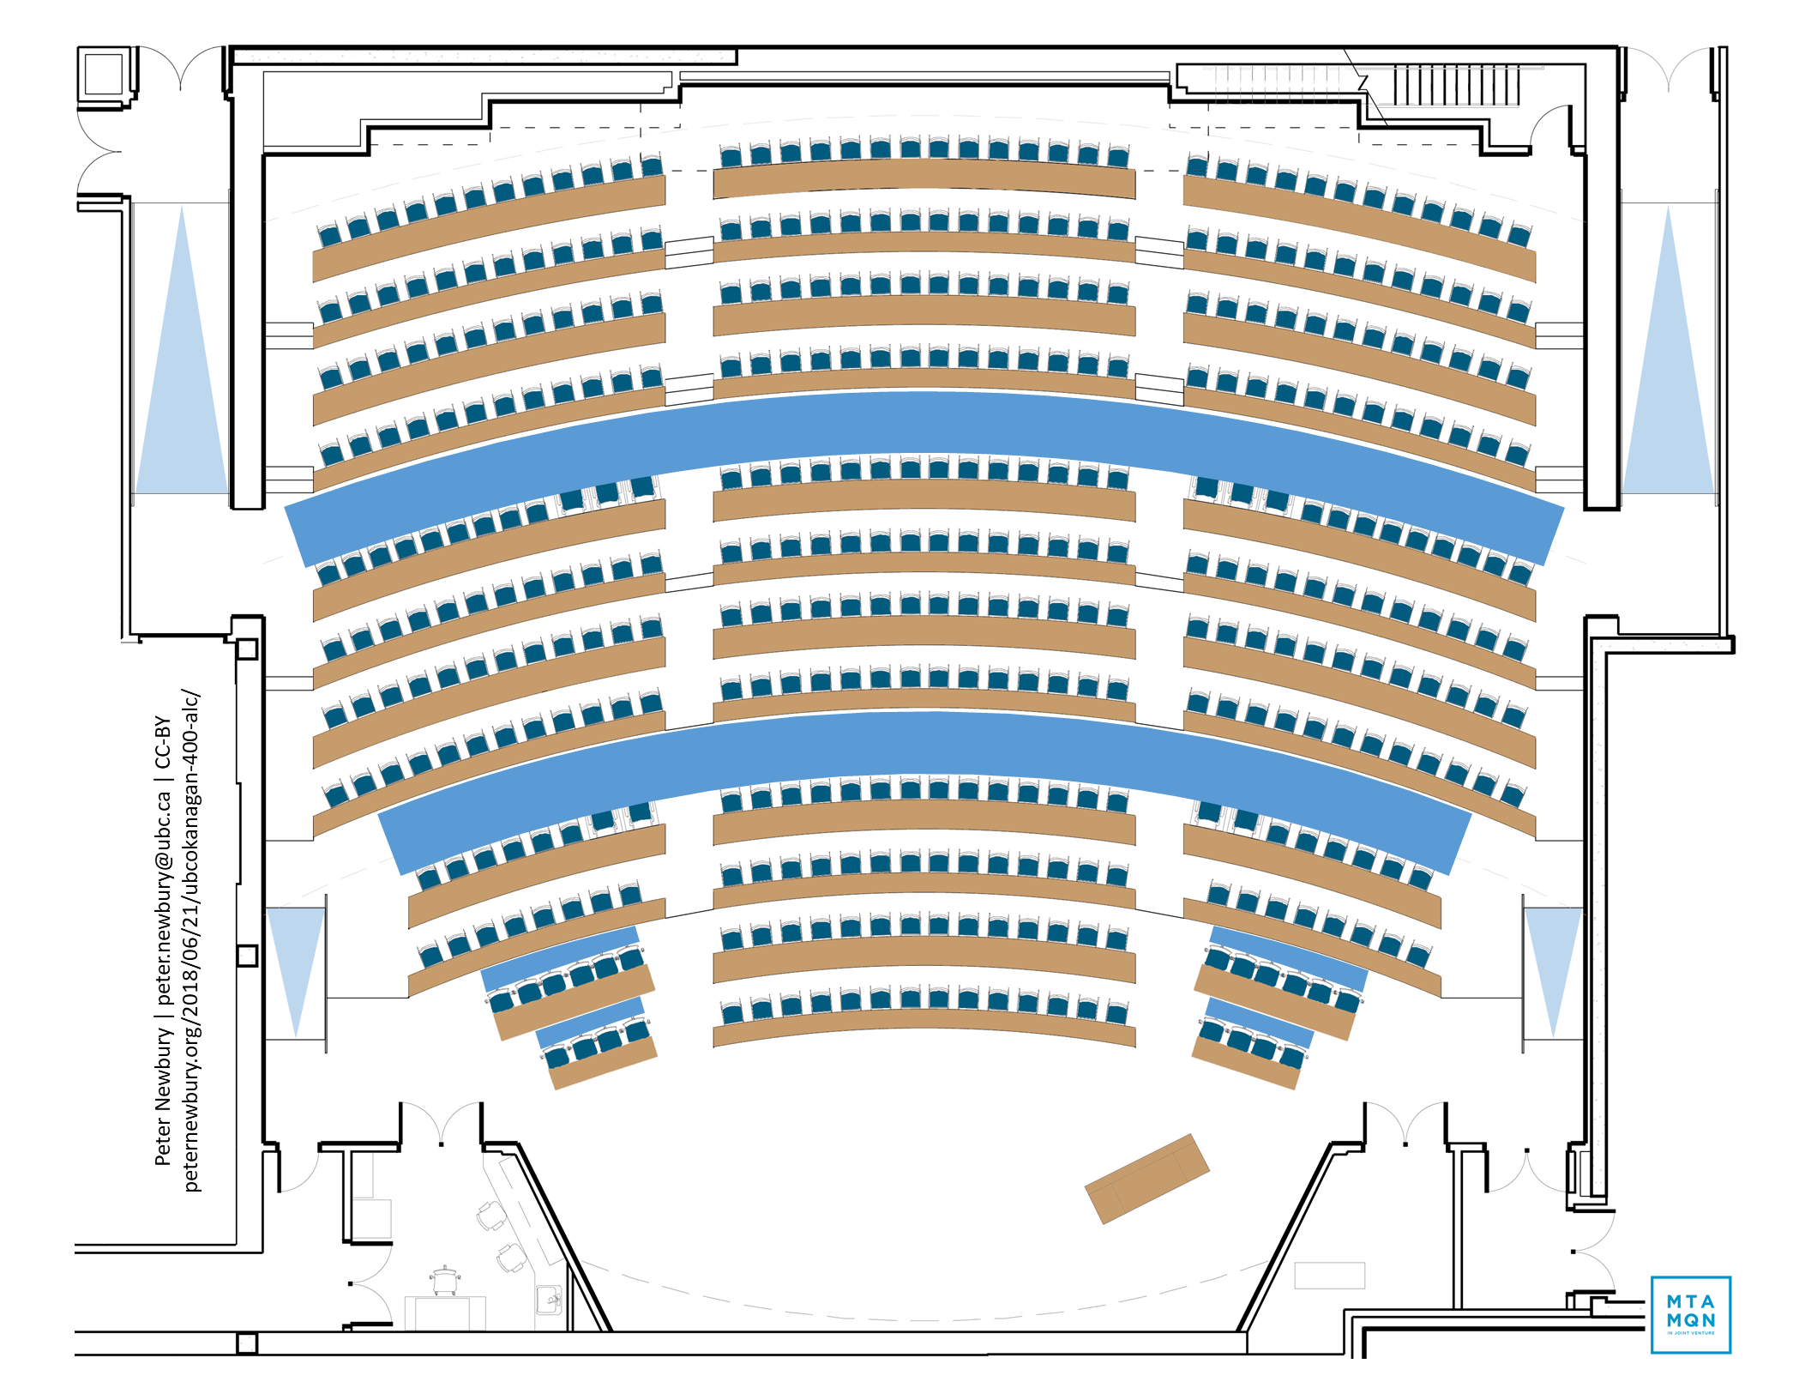
25
26
27
10
11
37
38
9
22
23
24
8
35
36
7
19
20
21
6
33
34
16
17
18
5
31
4
32
14
15
2
3
30
29
12
13
28
1
Do NOT cross aisle
Log to Canvas or Ms Team to know your team

Slide 19
Pseudo code: Binary search algorithm int bin(A,x)
Input: A: sorted array of n distinct numbers; x: number to find in the array
Output: i if A[i]==x or -1 (not found)
Return bin1(A,1,n,x)
Function int bin1(A, i, j, x)
If (j-i)<2 then return (A[i]==x)?i:-1;
eIse if A[(i+j)/2] < x then return bin1(A, (i+j)/2,j,x) else return bin1(A,i,(i+j)/2,x)
Complexity: runtime O(log n); space O(n)
Notes:
- Not precise Java code; write in English and use known algorithms e.g. sort array
- Do not worry about boundary/edge cases; focus on the main case

Slide 20
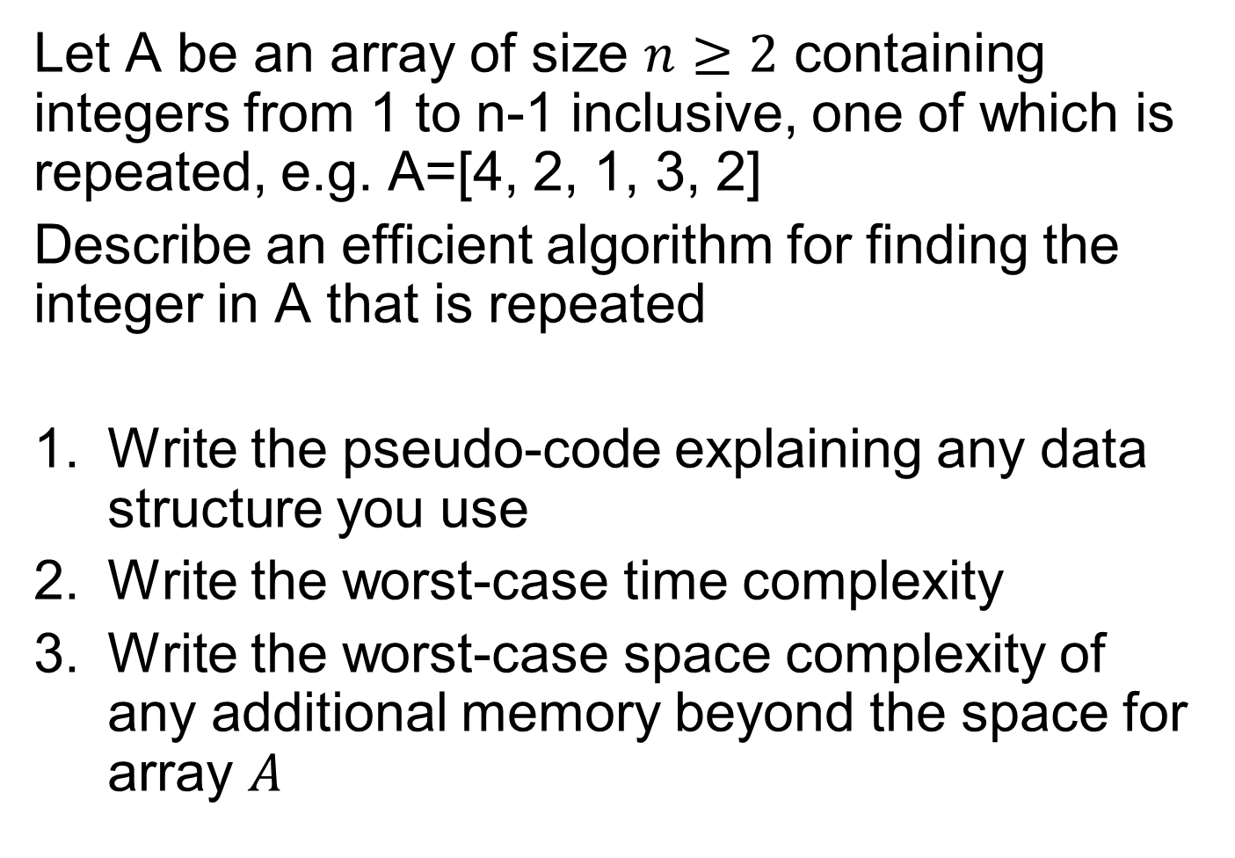
Let A be an array of size $n≥2$ containing integers from 1 to n-1 inclusive, one of which is repeated, e.g. A=[4, 2, 1, 3, 2]
Describe an efficient algorithm for finding the integer in A that is repeated
Write the pseudo-code explaining any data structure you use
Write the worst-case time complexity
Write the worst-case space complexity of any additional memory beyond the space for array $A$

Slide 21
Team build & critic
Do not forget to assign a TIMEKEEPER
[10 marks] Answer the questions on your poster
write clearly
Take picture and post it on Canvas as group assignment tMAT0
[4 marks] Rotate posters on each aisle (left, centre, right); do NOT cross aisle. Critic 4 posters. Make a list of any error, bug, omission; is complexity correct?
The full team has to agree on the justification
Upload your poster to tMAT0
Be quick! We have to start even if you haven’t finished writing your poster!
Include the list of team members present today
On your poster
DO NOT USE INTERNET except to submit tMAT
30’
4’
Per
poster
Notes:
15’ post-mortem
10’ quiz
30’ write poster
16’ read 4 posters
Total = 71’ [only read 3 posters if 3rd poster is after 1:40]

Slide 22
Solution

Slide 23
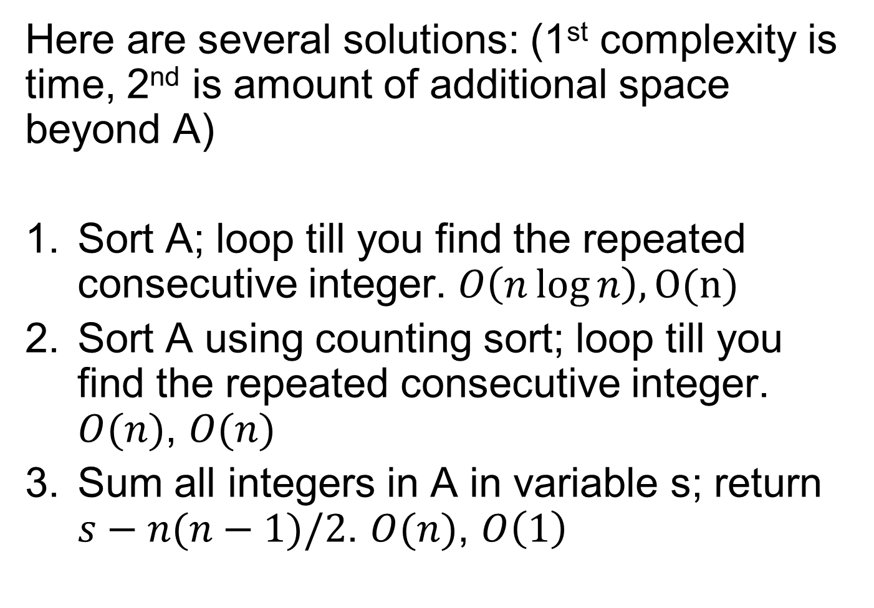
Here are several solutions: (1st complexity is time, 2nd is amount of additional space beyond A)
Sort A; loop till you find the repeated consecutive integer. $O\left(n\log{n}\right), O(n)$
Sort A using counting sort; loop till you find the repeated consecutive integer. $O(n)$, $O(n)$
Sum all integers in A in variable s; return $s−n(n−1)/2$. $O(n)$, $O\left(1\right)$

Slide 24
Detailed solution
Find the Duplicate Number is fully explained at https://leetcode.com/problems/find-the-duplicate-number/
Sol # | Time O(?) | Space O(?) | Description
1 | n log n | log n | sort
2 | n | n | set (counting sort)
3 | n | 1 | negative marking
4 | n | n | HashMap recursion
5 | n | 1 | HashMap iterative
6 | n log n | 1 | sum of set bits
7 | n | 1 | Floyd’s Tortoise and Hare (cycle detection)

Slide 25
Techniques
Common:
Sort, set (hashset/counting sort); binary search
Less common:
Negative marking, HashMap
Custom:
Sum of set bits
Floyd’s Tortoise and Hare

Slide 26
Next Time
submit iMAT through Connect
DEADLINE: 12:30PM
be ready for tMAT
Format: build & critic (same as today)

